Slide 1
Predicting Lag Price for Retail Products
A Machine Learning Approach
~ Hit Kalariya

Slide 2
Project Overview
Objective:
Develop a predictive model to determine lag prices for retail products, enabling better pricing strategies and demand forecasting.
Significance:
Assists businesses in optimizing revenue.
Improves decision-making in inventory management.

Slide 3
Data Collection
Dataset Information:
Size: 676 rows x 27 columns
Key Features:
Product ID
Current Price
Lag Price
Demand
Time-related features

Slide 4
Data Preprocessing
Steps Taken:
Handling Missing Values: Imputation techniques used to address gaps in the dataset.
Feature Scaling: Standardization or normalization applied for consistent feature scales.
Outlier Removal: Outliers detected using [IQR/Z-score] were addressed to ensure model robustness.

Slide 5
Exploratory Data Analysis (EDA)
Key Insights:
Price trends over time showed [highlight trend].
Strong correlation observed between demand and lag price.
Visualizations:
Histogram: Distribution of prices.
Scatter Plot: Relationship between lag price and demand.
Heatmap: Correlation matrix.

Slide 6
Feature Engineering
Techniques Applied:
Created lag features to capture historical price effects.
Derived new metrics such as average demand over specific periods.
Used time-based encoding to include seasonal effects.

Slide 7
Model Selection
Algorithms Evaluated:
- XGBoost regressor
- Nural Network
Training Process:
Training: 60%
Testing: 20%
Validation: 20%

Slide 8
Model Evaluation
Evaluation Metrics:
XGBoost Test Metrics:
Test RMSE: 51.4962
Test MAE: 30.5984
Test R2: 0.6766
Neural Network Test Metrics:
Test RMSE: 24.2170
Test MAE: 16.1715
Test R2: 0.9285
The Nural Network Model achieved the best performance with an RMSE of 24.2170.

Slide 9
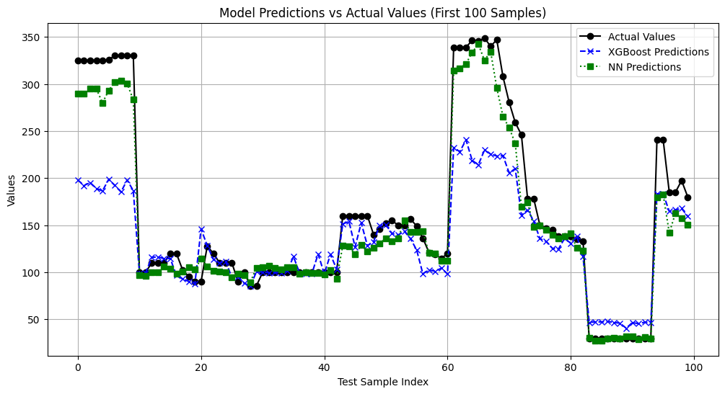
Key Results
Comparison of Predictions:

Slide 10
Conclusion and Future Work
Conclusions:
- Successfully developed a predictive model for lag price estimation.
- Significant correlation observed between lag price and demand.
Future Enhancements:
- Incorporate real-time data for dynamic predictions.
- Explore additional features like competitor pricing.

Slide 11
Q&A
Feel free to ask any questions!

Slide 12
Thank
You

